Slide 1

GROUP-14
Mohith Kota & Binghui Lai
Gaming Publish Model
December
2021

Slide 2
Business Problem
Now-a-days Video games are going digital. Most of the store platforms, whether online or offline, have their own databases to record all the Sales data. Some of them can be accessed by the public, like Steam DB, but all the data on different stores are not linked, which could bring a lot of trouble for Business Investigation and Analytics. Boston Consulting group decided to build a database to store the Sales data, as a consulting tool and open to their customer.
The database is solving practical problems in the gaming industry. For the publisher, it will help them to decide the publishing region while planning for a potential profit game. With this database they will get more data support rather than only relying on experience. When conducting competitive analysis, by searching for region, revenue, cooperated developers and other data of games published by their competitors they will stand a greater chance in the fierce competition.
The database is also an ideal tool for developers. They can find more business opportunities from different regions by catering specific needs of customers. By analyzing customers, they will have a clearer direction in the development.

Slide 3
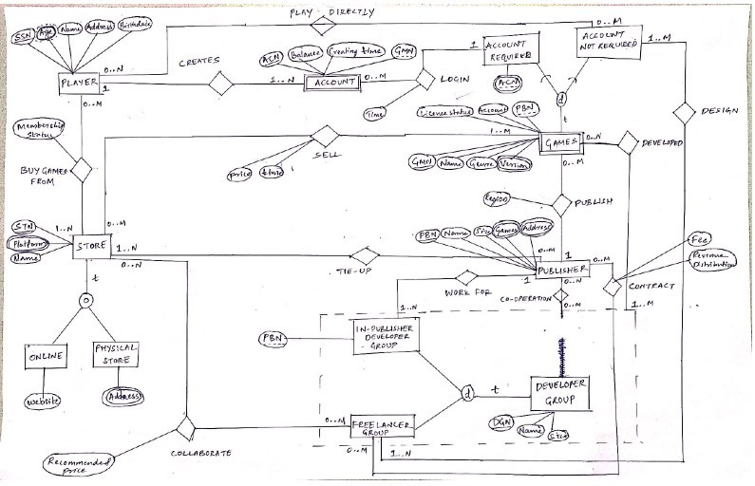
Designing ER and UML Model
Entities
Player
Store
Account
Games
Account Required Games
Account Not Required Games
Publisher
Developer Group
In-Publisher Developer Group
Free-lancer Group
Online Store
Physical Store
Relationships
Play Directly, Creates, Buy Games from, Sell, Login, Tie-up, Publish, Design, Developed, Work for, Collaborate, contract, co-operation

Slide 4
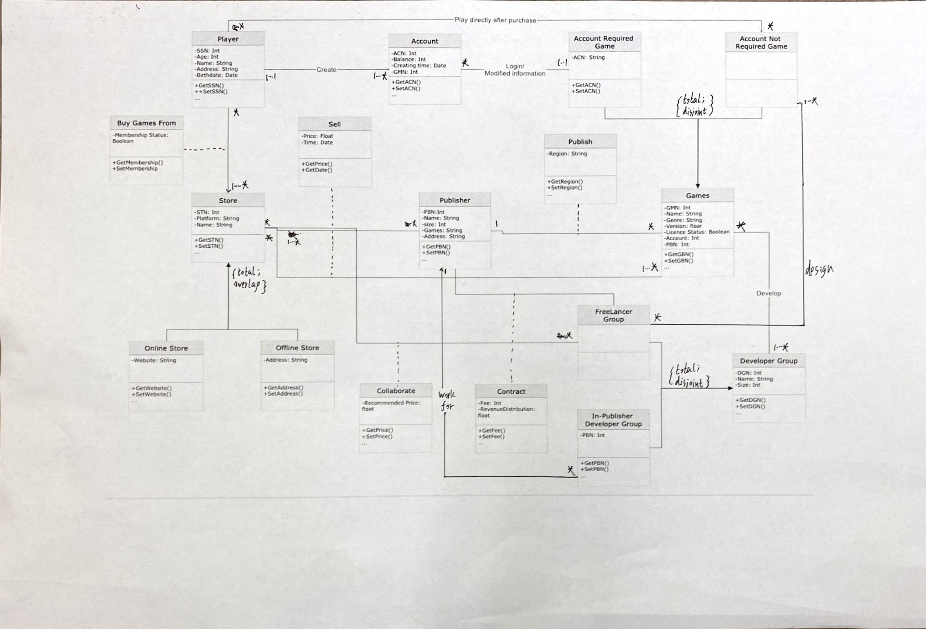
We have created a Schema in MySQL by using our Relational Model designed using our ER and UML Model. We have created multiple tables of our database using Entities and Relationships from the model. We have created primary key, foreign key relationships. We tried some queries to check whether the data was imported properly or not.

Slide 5
Implementation of MySQL

Slide 6
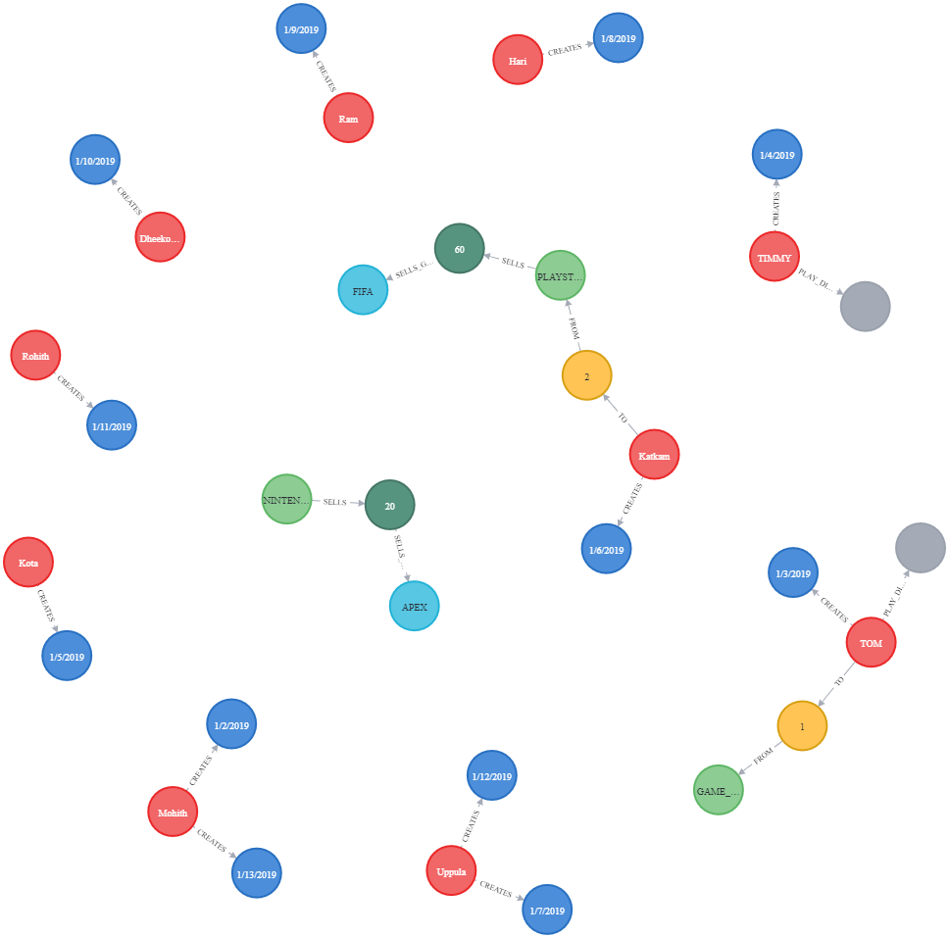
Implementation of NoSQL in Neo4j Desktop

Slide 7
Visualization using Python

Slide 8
Recommendation
The gaming publish database designed on MySQL targeting at providing a tool to store, organize, modify gaming publish data. With this database it will be easier to manage data including input and delete operation, searching data for analysis of the gaming industry. We have some sample query in the report as well as a link to python for usage under multiple environments.
While the database is ready for implementation, there are still some improvements that should be considered in the future. Firstly, the database doesn’t have any governance measure to ensure the data quality, because of which after a period using the database may not be in a well-organized status. For suggestions, the function built inside of database software or outer programming language like python should contribute to this improvement.
The NoSQL database is also available. But we also have some concerns about it. Firstly, NoSQL is not used as widely as MySQL world-wide. NoSQL hasn't got a formal query language so it may bring difficulties to users of this database to get familiar with that before implementing in real cases. The development kit is not as well-developed as MySQL either. However, in this case the database is not required to keep all-time consistency, periodically modified should be enough. NoSQL can provide a higher efficiency for users in this case.

Slide 9

THANK
YOU!

